Slide 1
Computer vision final project: mosaic
By:gayanath sasitharanathan

Slide 2
Intro/background
The project i implemented was a simple mosaic stitcher capable of stitching together multiple images together that resembled the same properties. In order to select images to stitch together without changing from the overall image, I had to choose/compare from a set of images based on the original color of that tile.

Slide 3
Approach
In order to implement stitching I had to first download a image data set that contained images of the same properties/colors.
These images had to be resized/ cropped and saved to a different folder in order to use them for the stitching. The original images were too big so I scaled it down but the option of choosing length was given in the processing java file so that different image sizes could be selected. I defaulted to a length of 100 initially but the image was too small so changed the value to 200.

Slide 4
Approach cont’d
I then implemented a function to average H,S,V,R,G,B for each image and used open-cv histogram functions to extract average colors.

Slide 5
Stitching
The average color was calculated based on the channel of the histogram
This was then normalized to the number of pixels
The distance was calculate using the Euclidian distance function to calculate vector distance
The image stitching was then done using a double ended queue, to select images at random based on the average colors of each tile previously calculated along with using the Euclidian distance function previously defined to keep track of distance between images.

Slide 6
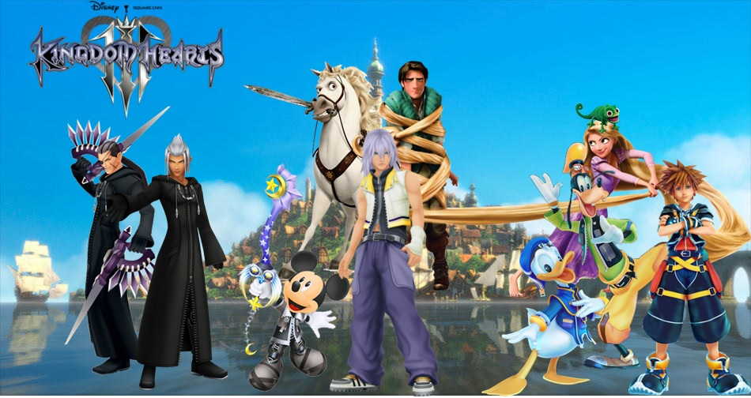
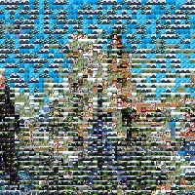
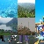
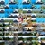
Sample files created
Original Image
Image stitched with length 50/100 and tile size 20, 10 and 5

Slide 7
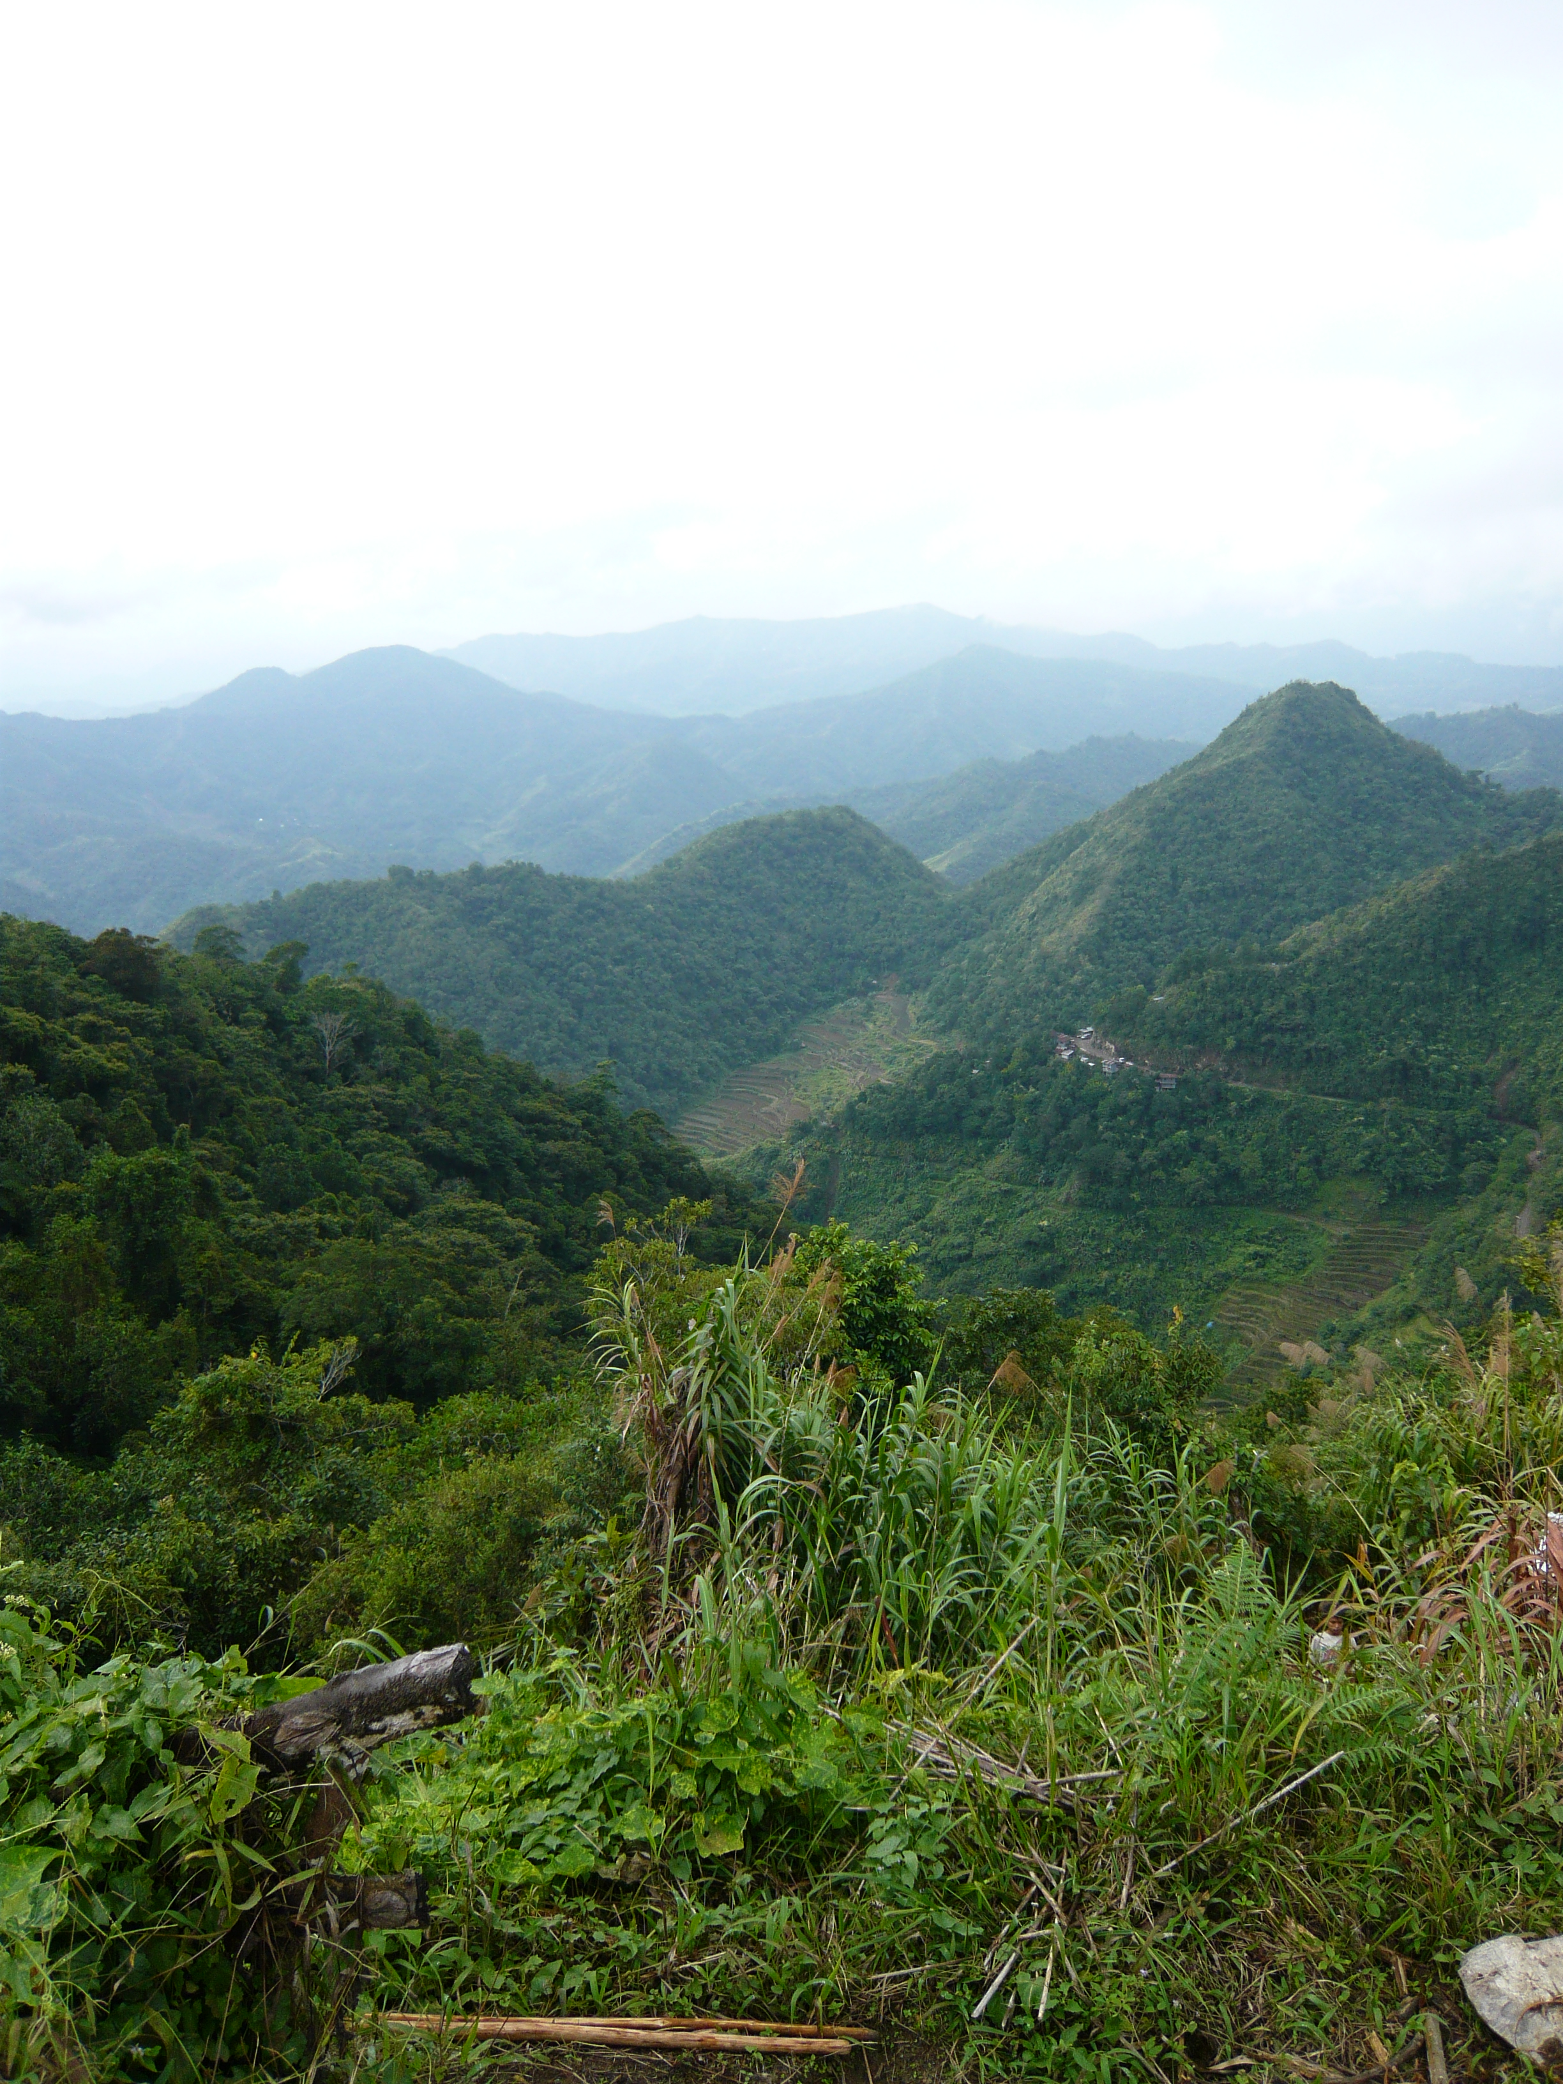
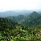
Sample cont’d
Original Image
Image with length 50 and tile size 10

Slide 8
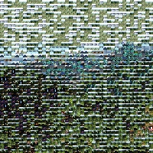
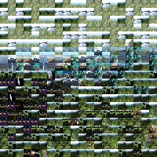
Sample cont’d
Image with tile size 5 and length 200
Image with length 100 and tile size 10

Slide 9
DEMO

Slide 10
Questions

